Slide 1

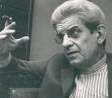
Lecture Three: Freud and Lacan

Slide 2
Freud’s ‘Copernican Revolution’
Just as Copernicus discovered that the earth is not the centre of the universe - so Freud discovered that the ego (seat of conscious thought) is not the centre of the subject, is not in charge of the subject.
The I (ego) is displaced by the unconscious, a dimension that the subject is often not even aware of and has little control over. There is a whole field of unconscious thought processes, complex symbolic structures, aggressive drives and instincts, desires, that not only are we not conscious of yet which often determines our behaviour, makes us act in ways that are seemingly irrational. The ‘dark continent’.
Amounts to a revolution in the study of the subject. The subject is split between his conscious and unconscious selves.
Undermining of the Cogito: all Western philosophy and political theory since the time of Descartes has been based on Cogito Ergo Sum - I think therefore I am. In other words, the subject is anchored in rational, transparent, self-reflective thought: we know we exist because we are aware of our own thought. But Freud says: where he is not, he is thinking: where he is not thinking, he is. In other words, we have unconscious thoughts that we are unaware of and have a life of their own. We therefore cannot situate ourselves wholly around the conscious I (ego) because there is something else going on - an ‘other scene’. We are strangers to ourselves.
The unconscious is the place of the drives (Trieb) - the aggressive instincts; incestuous sexual desires; unconscious fantasies. These desires become repressed as we grow, but they remain in tension with our conscious, rational selves.

Slide 3
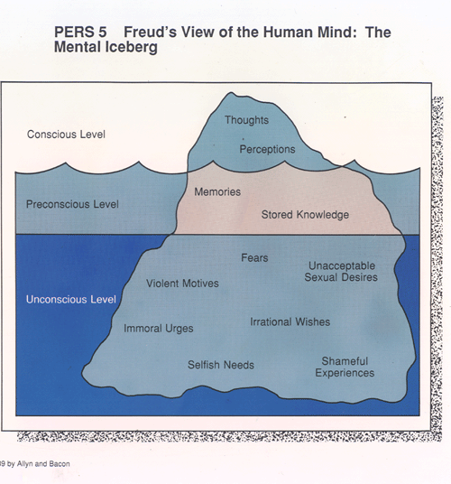

Slide 4
Freud’s theory of psychic conflict
Conflict is central to our mental life: conflict between certain thoughts, ideas, memories desires which are unpleasant, shameful, inappropriate, irrational, associated with guilt (always to do with sex, sexual emotions are the key emotions) and the other part of the mind (ego, superego) which refuses to admit them, which represses them.
This conflict which produces neurotic symptoms – eg hysteria, obsessive behavior, phobias, anxieties.

Slide 5
Manifestations of the unconscious
Dreams – an example of the unconscious speaking.
  Dreams are a form of repressed ‘wish fulfilment’ where desire emerges in a distorted form due to internal censorship (Interpretation of Dreams)
Mistakes - these are not simply accidents but reveal unconscious thought processes
  Slips of the tongue (parapraxes) the ‘Freudian slip’.
    Slips emerge in a distorted way through attempt to repress or censor unconscious impulses
  misreading or mishearing something
  mislaying objects
  forgetting names and dates
  Bungled actions
  Repeating self-destructive behaviour.
Neurotic and hysterical symptoms – often bodily symptoms (spasms, paralysis) for which there is no medical explanation – but which are connected to mental conflict and are an expression of some sort of psychic trauma. Often connected symbolically to certain words – which shows the significance of speech for psychoanalysis
The ‘talking cure’: treating symptoms through ‘free association’, ie speech without censorship or repression was a way of letting the unconscious speak.

Slide 6
Political implications of psychoanalysis
Politics is traditionally based on the model of the rational, autonomous subject who can make an objective judgement about the world, who perceives his self-interest and who acts in a utility maximising way (central to liberal theory)
Freud shows that this model of the subject neglects the irrational, aggressive, sexualised side of ourselves, which influences our political behaviour in all sorts of ways. In other words, politics can no longer be seen only in terms of the rational pursuit of individual preferences, but also in terms of passions, desires, unconscious motivations, aggression and self-destructive behaviour. This equally affects their political decision making.
Even on a superficial level, if we look at politics we see that people are carried away by all sorts of emotions, irrational fears, inordinate desires, passions, extreme ideologies – eg irrational fears about terrorism and immigrants, ideas of racial and national superiority, hatred of the other.
Critique of idea of negative freedom (which is also basic to liberalism) > idea that we are free to do something provided we are not prevented by external prohibitions or obstacles – in liberalism, the goal is to minimise these obstacles, provided that security for everyone is guaranteed (liberty is where the law is silent). However, what if this impediment to our rational decisions is not external to us, but internal?
  According to psychoanalysis, the Law of Prohibition is not only external to us, it is also internal. Eg, inhibitions and anxieties.
  Prohibition often takes the form of the superego which internalises social norms and acts to censor and inhibit us, causing us to suffer. The liberal discourse of rights and formal freedoms simply has no relevance to the unconscious.
  There is also an erotic dimension to prohibition and law – we often enjoy our own repression and suffering – eg in obsessional neurosis, masochism.
Liberalism doesn’t have the conceptual apparatus to deal with the unconscious in politics.

Slide 7
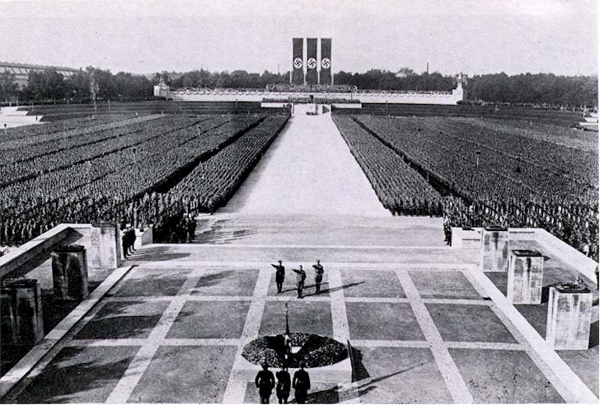
The irrational side of politics: Nazi rally at Nuremberg

Slide 8
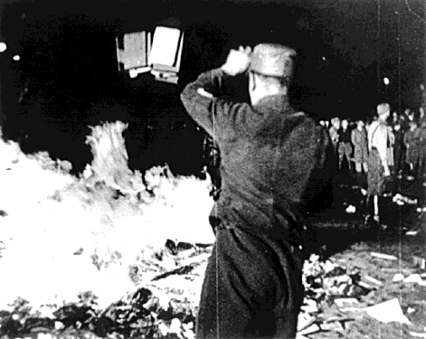
The irrational side of politics: Nazis burning books

Slide 9
Group psychology
Group Psychology and the Analysis of the Ego (1921)
how to explain the political phenomenon of mob behaviour and the political group? – individuals behave differently when they are part of a group – their ego seems to be transcended and repressive inhibitions are thrown off; individual responsibility is abrogated.
Mob or group behaviour is a phenomenon of modern mass society - containing highly complex structures of love and identification.
What makes group behaviour possible is the figure of the leader. Groups are formed and held together through a relationship of love (libido) and identification between group and the leader. Love for the leader takes over from the love for oneself, for the instinct of both self-preservation and individual responsibility. The leader allows the individual to forget about his own ego, and to identify himself with a love-object.
Many organizations and group identities are built on a shared love relation between the group and the leader. The leader becomes a father-substitute in many cases, and love is transferred onto him
  Church - Christ as father of the flock
  Army - General or captain as father who loves his soldiers as sons.
  There is also the case of the totalitarian leader or master - the Fuhrer - who is loved by his followers.
So libido is the tie that holds group together. The leader becomes the point of identification for the group - it is only through the leader that members of the group can love and identify with each other and a collective identity is formed. When the leader dies that group falls apart.
So often political identities are formed, not through rational action or deliberation, but rather through irrational passions and libido.

Slide 10
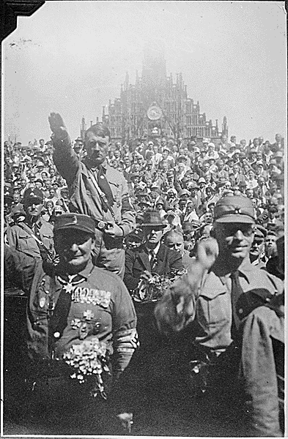
Love of the Leader

Slide 11
Civilisation and its Discontents (1929)
There is a central tension between the demands and restrictions imposed on us by civilisation, and our natural aggressive and sexual instincts which we have repressed as the price for entering society. This tension often leads to neurotic suffering.
Civilisation demands that we repress our more violent and aggressive tendencies, because these are a permanent threat to social cohesion –
  Repression of Oedipal desire – becomes taboo
  Sublimation of genital love (fixed on one person) into love for others, for the community.
but there is a high price to pay for this. This is expressed in a widespread hostility towards civilisation.
We have renounced our aggression and violence, but these impulses remain within us and sometimes explode – primeval rage, sexual perversion, violence, war.
The most unbearable demand of civilisation is that we should love one’s neighbour as oneself. But it is more natural to distrust and even hate our neighbour. We are not gentle creatures worthy of love – we are violent, sadistic, aggressive (man is a wolf to man – Hobbes)
Civilisation is caught in the balance between Eros (life instinct – love of others), which is necessary for civil co-existence, and the death instinct (drive towards death and destruction). Our violent instincts threaten to destroy civilisation.
Civilisation curbs the aggressive instinct by directing it inwards, turning it back upon ourselves (the ego) instead of outwards towards others. This internalised aggression becomes the Superego (forms the conscience) - that harsh self-accusatory voice that punishes us and makes us feel guilty, even for things we haven’t done: a “garrison in a conquered city”.
The superego keeps watch over us – curbs our destructive impulses (which serves the purposes of civilisation) and exercises a censorship over us - but the price we have to pay for this is neurotic guilt. Guilt serves a vital social purpose, but it brings with it suffering.
Guilt is therefore central to civilisation – and the price we pay for it.
The problem is also that sometimes the death instinct is turned outwards, towards society, towards other people: this psychic rage is sometimes turned outwards, to society, to other people
  Rage, urban violence, war, sadism/masochism, cruelty, enjoyment at humiliating others, genocide, the nihilistic urge to destruction.

Slide 12
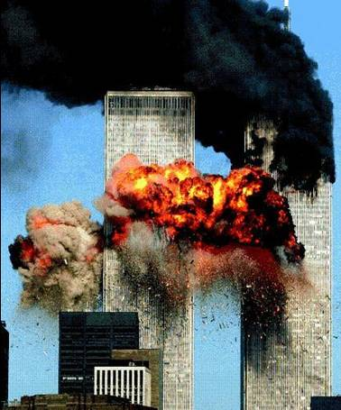
The death instinct – nihilistic destruction

Slide 13
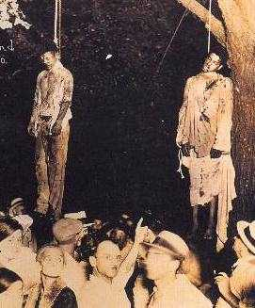
The death instinct – aggression and hatred of the other

Slide 14
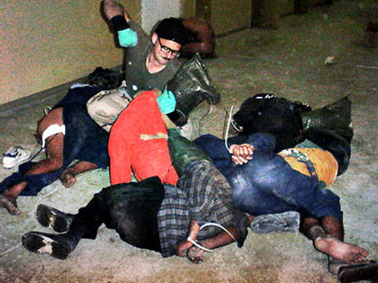
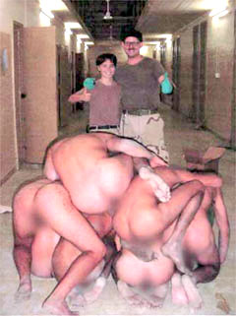
The death instinct – violence, cruelty and perverse enjoyment

Slide 15
Lacan: alienation and lack in the subject
Like Freud, Lacan questions the Cartesian subject of the Cogito – rather the subject is split, lacking, and alienated from the object of desire.
When the subject engages with the external world – particularly with language as an alien structure – he is separated from the original (and imaginary) enjoyment (jouissance) with the mother.
We can never retain this lost enjoyment – and this is what generates desire which can never be fulfilled. We can never achieve a complete, whole identity.
First stage of alienation - The Mirror Stage: reflection of oneself in mirror produces illusory and ultimately unstable sense of bodily unity.
Second stage – alienation within language, the Symbolic Order (the Other): when we enter world of language we are confronted with an external, alien structure which we have no control over (ala Levi-Strauss), and yet which we have to engage with in order to survive. We search in vain for a recognition of ourselves in the signifier. We are lacking in the Other.

Slide 16
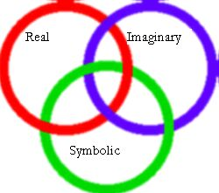
RSI: Lacan’s structure of human experience

Slide 17
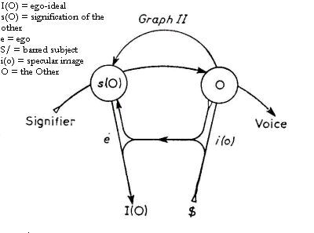
Lacan’s Graph of Desire

Slide 18
Lack in the social order
Lacan argues that it is not only the subject that is lacking, but that the social order itself is also lacking structurally
Because the social order is understood only through language, and because language is inherently limited, it cannot properly or completely grasp reality
There is always something outside language, some kind of ungraspable element – which Lacan calls the Real. The real is not the same as simple ‘reality’ (in other words, Lacan is not making the naïve point that reality exceeds language) > but rather that the structure of language, which expresses reality, is itself lacking and incomplete, and there is some sort of abyss or void which eludes it, and which unsettles the coherence of any social order.
In Lacan’s terms, not only is the subject alienated in the Other (through lack) but that the Other itself is also lacking. There is no Other of the Other.

Slide 19
Political implications
Focus on the role of fantasy in politics and ideology - because the social order is lacking, because it cannot be successfully symbolised or represented, this means that there is not one way of looking at the world, there will always be competing ideologies which try to present a certain coherent picture of society and present radical solutions to solve social problems.
Utopian element in political ideologies: the belief that somehow all the world’s problems can be solved, which is based on the fantasy of social fullness. In other words, the sense that there is something missing from society, some integral problem or dislocation in society, is what generates utopian political ideologies with the idea that we can repair the world, make the world whole again
For instance, racist anti-immigrant ideology: fantasy that immigrants are the reason for crime, social and moral decay, unemployment etc, rests on the fantasy of a lost social fullness which existed prior to immigration (an image of a harmonious, crime free, stable social order, monocultural, cohesive communities etc) and to which we can return.
  The function of the ‘Jew’ in Nazi anti-Semitic discourse – propaganda.
  Zizek: What is central to racist and xenophobic ideologies is the conviction that immigrants have stolen something from us – some sort of enjoyment which was originally ours: “In short, what really gets on our nerves, what really bothers us about the "other", is the peculiar way he organizes his jouissance (the smell of his food, his noisy songs and dances, his strange manners, his attitude to work - in the racist perspective, the "other" is either a workaholic stealing our jobs or an idler living on our labor.” ( Zizek, Looking Awry)
Role of desire in advertising. The advertising industry, and capitalism more broadly, work by selling us the promise of jouissance or impossible enjoyment, thus perpetuating the endless desire for consumer goods.
The importance then of a psychoanalytic analysis (both Lacan and Freud) is that to understand how society and its ideology function, we not only need to understand its social, political and economic institutions and practices, but also the unconscious forces (like fantasy, enjoyment, desire, libido etc) which sustain it > and it is only in this way that we can construct a more effective politics.

Slide 20
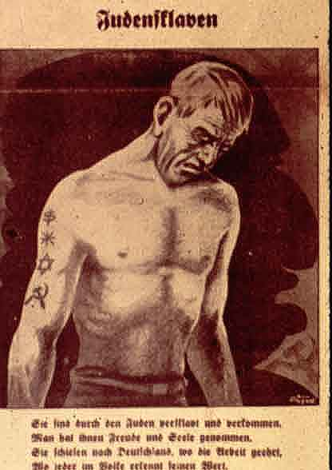
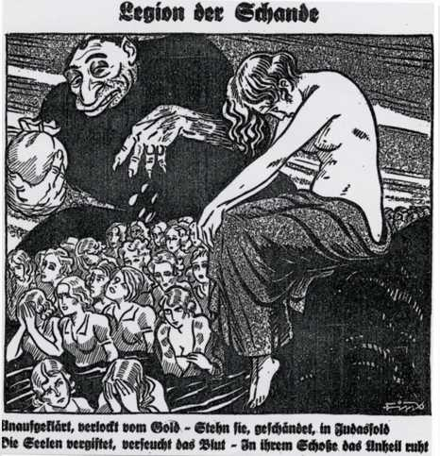
Stolen enjoyment and the fantasy of the Jew in Nazi anti-Semitism.

